Slide 1
Second Year B. Tech. Advanced Data Structures (CS228)
By
Dr. Pramod D. Ganjewar
Senior Assistant Professor,
School of Computer Engineering,
MIT Academy of Engineering, Alandi(D.),Pune

Slide 2
Unit – 1 Trees Types of Binary Trees

Slide 3
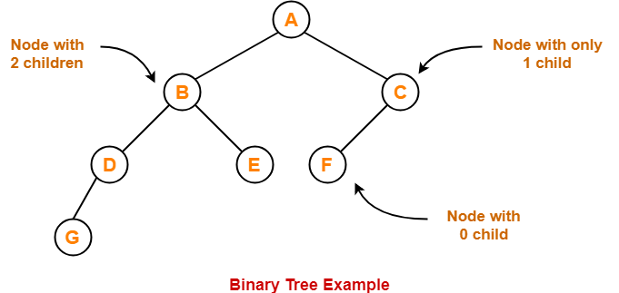
Binary Tree
Binary Tree
Binary tree is a special tree data structure in which each node can have at most 2 children.
Thus, in a binary tree, Each node has either 0 child or 1 child or 2 children.

Slide 4
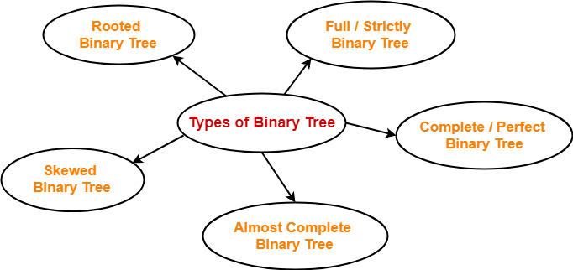
Types of Binary Tree
Binary trees can be of the following types

Slide 5
Types of Binary Tree
Binary trees can be of the following types
Rooted Binary Tree
Full / Strictly Binary Tree
Complete / Perfect Binary Tree
Almost Complete Binary Tree
Skewed Binary Tree

Slide 6
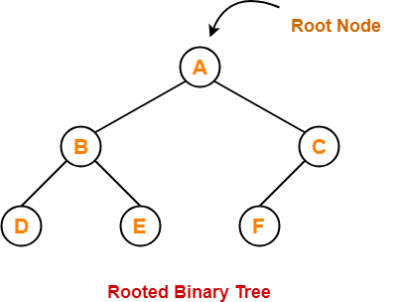
Types of Binary Tree
Rooted Binary Tree
A rooted binary tree is a binary tree that satisfies the following 2 properties-
It has a root node.
Each node has at most 2 children.

Slide 7
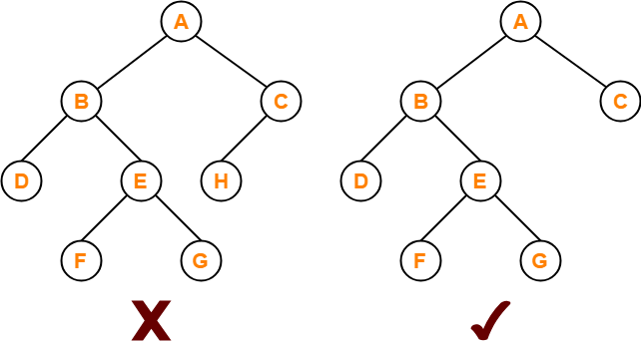
Types of Binary Tree
Full / Strictly Binary Tree-
A binary tree in which every node has either 0 or 2 children is called as a Full binary tree.
Full binary tree is also called as Strictly binary tree.
Here,
First binary tree is not a full binary tree.
This is because node C has only 1 child.

Slide 8
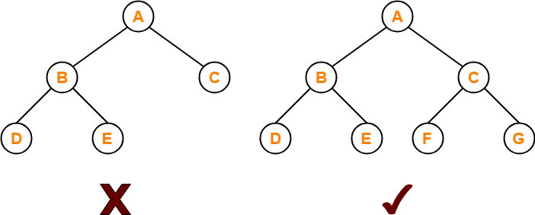
Types of Binary Tree
Complete / Perfect Binary Tree
A complete binary tree is a binary tree that satisfies the following 2 properties-
Every internal node has exactly 2 children.
All the leaf nodes are at the same level.
Complete binary tree is also called as Perfect binary tree.
Here,
First binary tree is not a complete binary tree.
This is because all the leaf nodes are not at the same level.

Slide 9
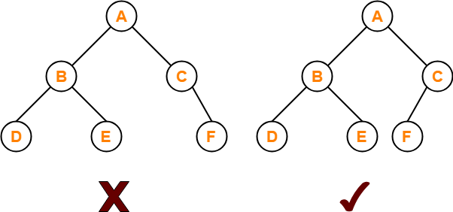
Types of Binary Tree
Almost Complete Binary Tree
An almost complete binary tree is a binary tree that satisfies the following 2 properties-
All the levels are completely filled except possibly the last level.
The last level must be strictly filled from left to right.
Here,
First binary tree is not an almost complete binary tree.
This is because the last level is not filled from left to right.

Slide 10
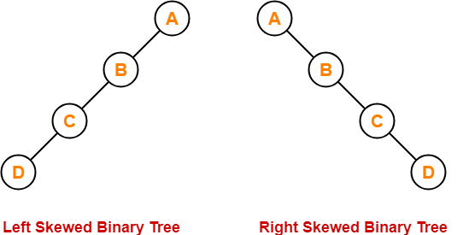
Types of Binary Tree
Skewed Binary Tree
A skewed binary tree is a binary tree that satisfies the following 2 properties-
All the nodes except one node has one and only one child.
The remaining node has no child.
OR
A skewed binary tree is a binary tree of n nodes such that its depth is (n-1).

Slide 11
Thank You

